Slide 1
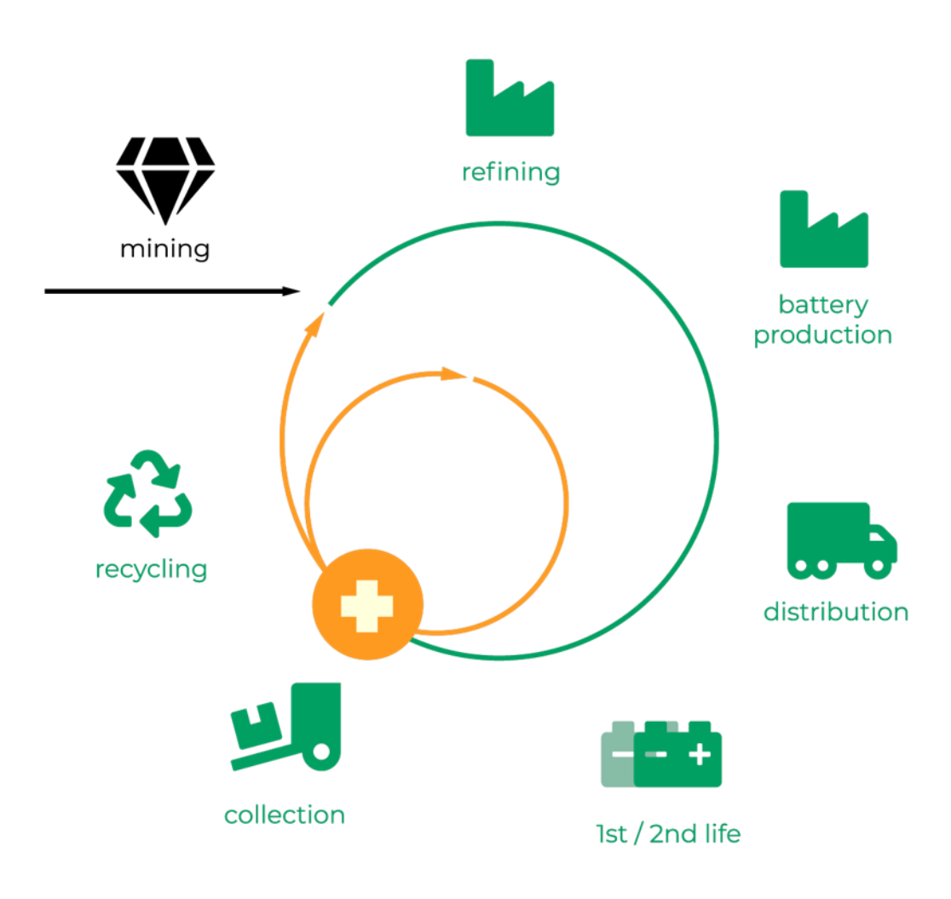
Critical Raw Materials for Li-ion Batteries
SERAY COŞKUN
AHMET MUSAB BEŞBADEM
EBRU BAYAM
ENES KARA

Slide 2
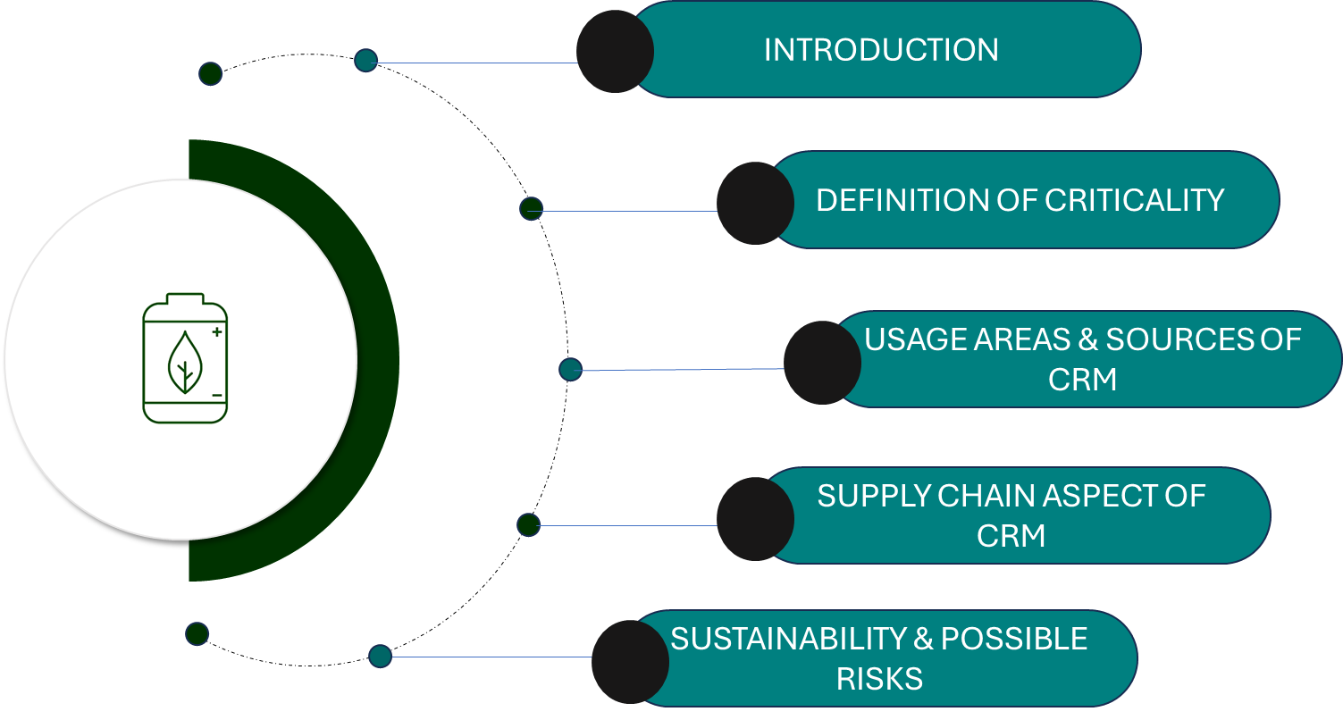

Slide 3
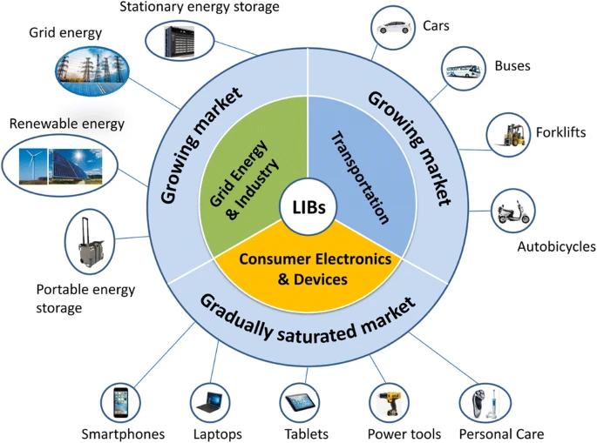
LITHIUM-ION BATTERIES
POWER BACKUPS
MOBILE,LAPTOPS, DEVİCES
ELECTRIC MOBILITY
ENERGY STORAGE SYSTEM
APPLICATIONS
ADVANTAGES
High energy density
Low self-discharge rate
Variety of types available
Low maintenance
No requirement for priming

Slide 4
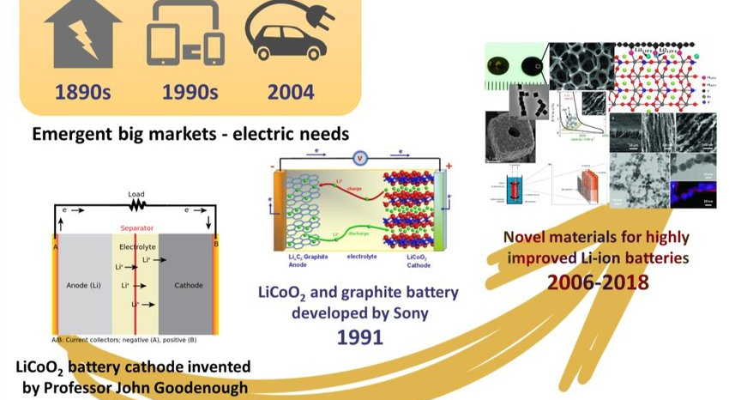

Slide 5


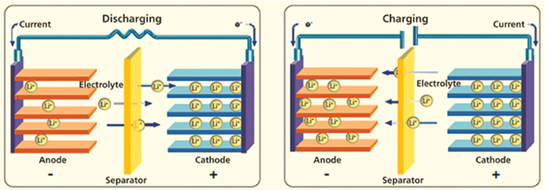
BASIC PRINCIPLES OF LI-ION BATTERIES
CATHODE
ANODE
SEPARATOR
ELECTROLYTE

Slide 6
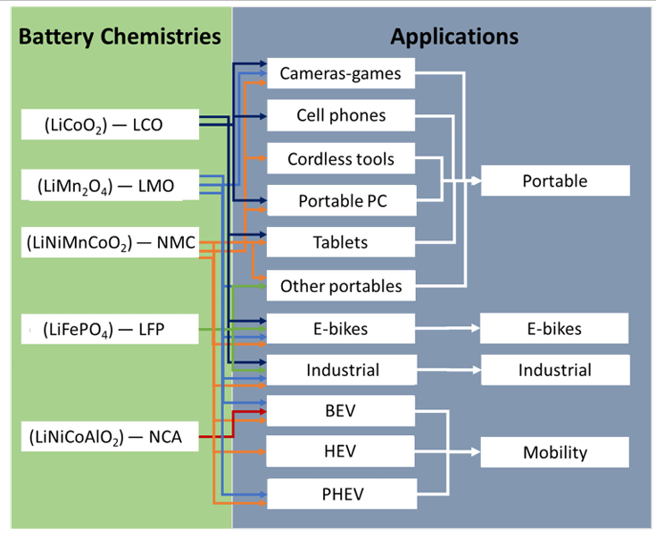
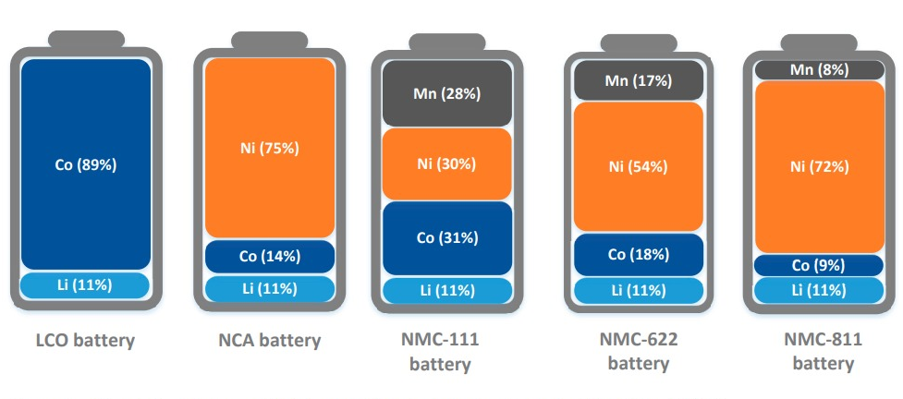
CATHODE MATERIALS FOR LI – ION BATTERIES
Cathode materials are the most expensive part of the battery cell
Most common cathode materials are LCO,LMO,NMC,LFP and NCA.
Li,Ni,Co,Mn and Graphite are mainly used during production of cathodes.

Slide 7
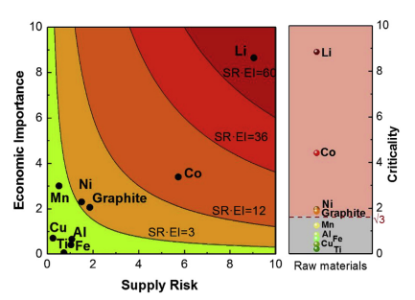
DEFINITION OF CRITICALITY
"Criticality" refers to the degree of importance and strategic value of a material or resource. In the context of lithium-ion batteries, the criticality of the materials used in these batteries indicates their significance and sensitivity within the supply chain.

Slide 8
CRITICAL RAW MATERIALS IN LI-ION BATTERIES
Critical raw materials are essential for economy, yet they face a high risk of supply disruption due to limited sources and lack of viable substitutes. To address this issue, the EU has implemented various strategies and policies.
HIGH IMPORTANCE FOR KEY & MAJOR TECHNOLOGIES
HIGH PROBABILITY OF SUPPLY DISTUPTION
SUPPLY SHORTAGE WITH IMPACTS ON ECONOMY
FEW OR NO SATİSFACTORY SUBSTİTUES
CRITICAL RAW MATERIALS IN LI-ION BATTERIES
LITHIUM
MANGANESE
GRAPHITE
NICKEL
COBALT

Slide 9
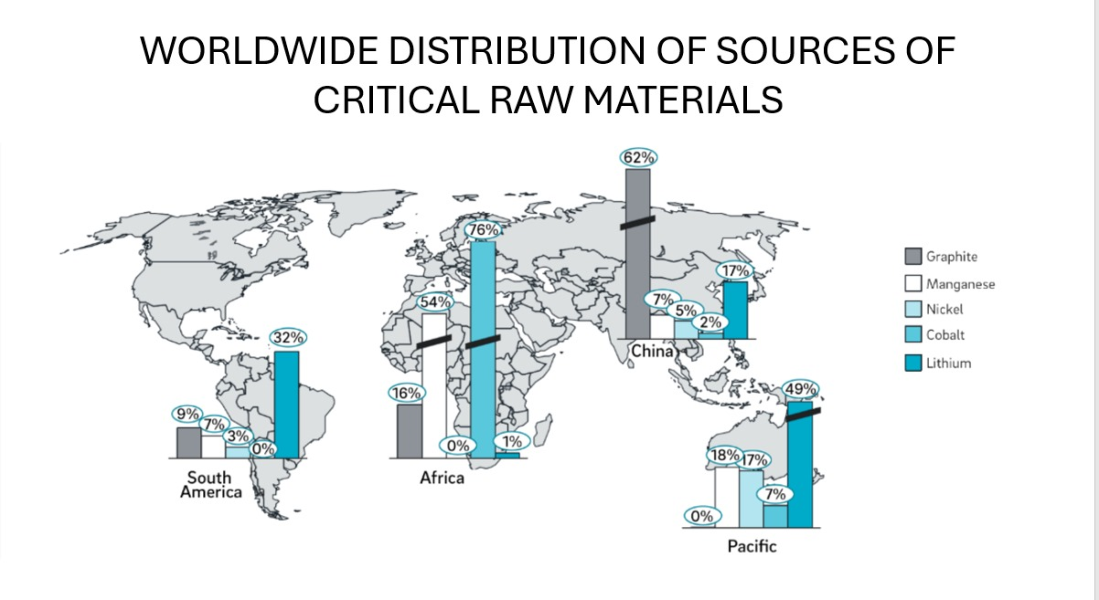

Slide 10
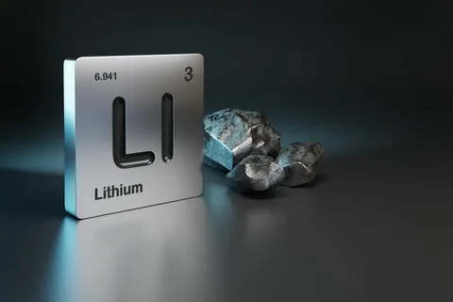
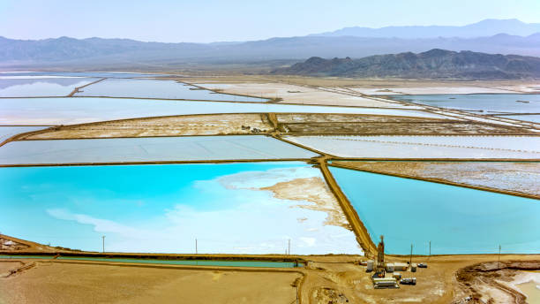
Lithium - A Critical Element
Lithium is an essential component of the cathode material in lithium-ion batteries.
It is the lightest metal and possesses unique electrochemical properties that make it ideal for battery applications.
Lithium demand is projected to grow exponentially in the coming years due to the increasing adoption of lithium-ion batteries.

Slide 11
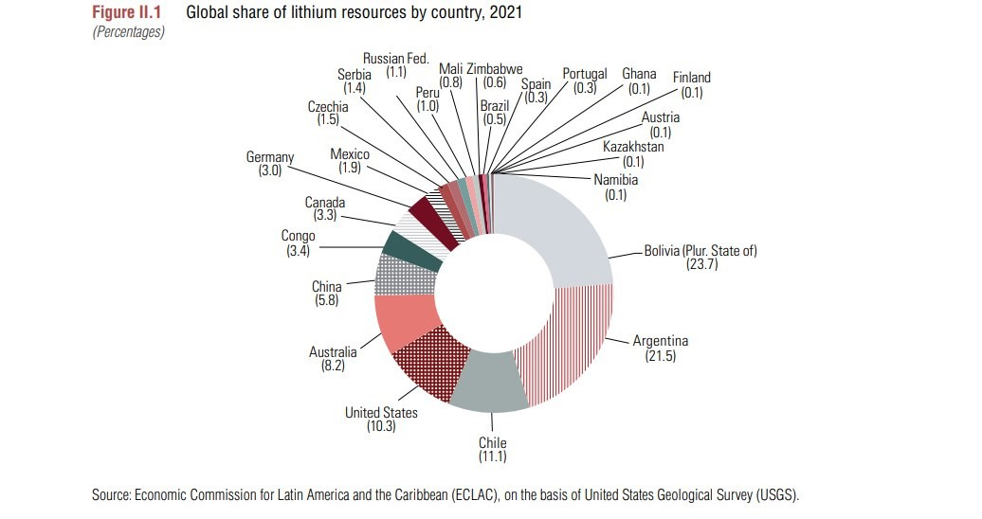
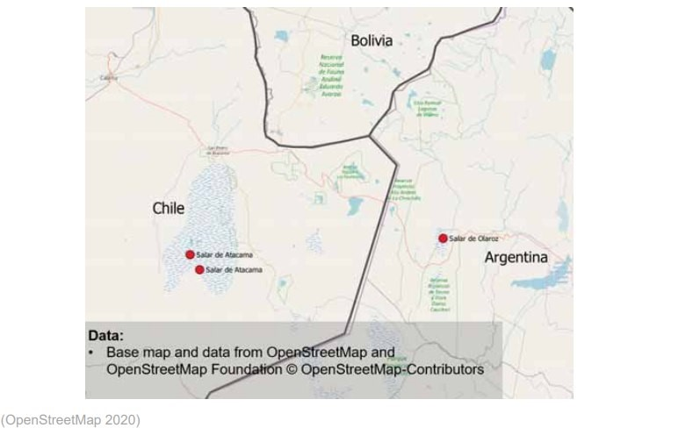
LITHIUM RESOURCES & DISTRIBUTION
Lithium resources are not evenly distributed around the world.
Key regions with significant lithium reserves:
South American Lithium Triangle (Bolivia, Chile, Argentina) - 53% of global reserves.
Australia, China, and the United States also hold substantial reserves.

Slide 12
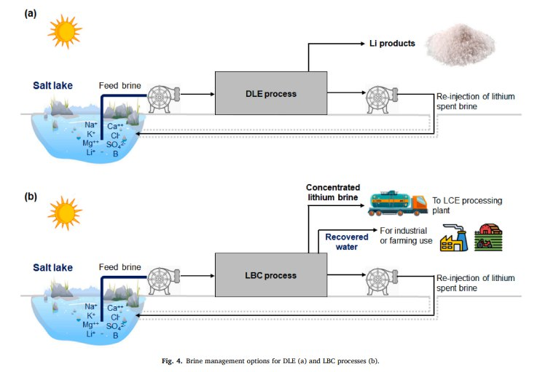
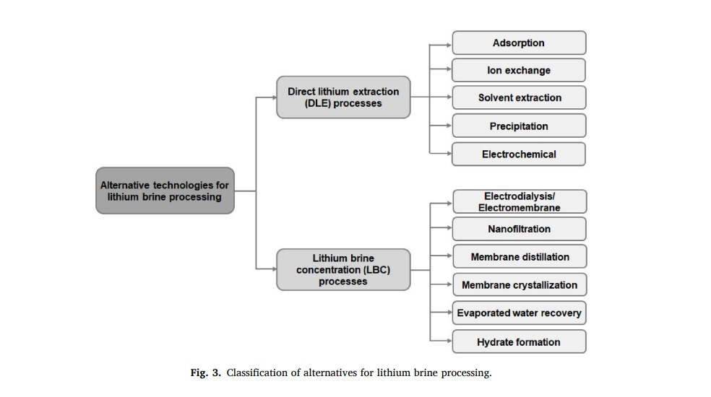
LITHIUM EXTRACTION METHODS
The resources of lithium are primarily divided into three categories.
The first are brines, the other two categories are pegmatites and Sediment-Hosted Deposits.
Conventional Lithium Extraction from Brines:
Involves solar evaporation ponds to concentrate lithium.
Leads to high water consumption and environmental concerns.
Alternative Lithium Extraction Methods:
Direct Lithium Extraction (DLE):
Aims to selectively extract lithium from brines.
Offers potential for reduced water usage.
Lithium Brine Concentration (LBC):
Concentrates lithium brine without separating lithium.
Can involve freshwater use but aims to reduce water loss compared to conventional evaporation ponds.

Slide 13
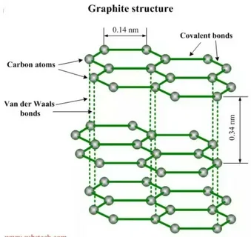
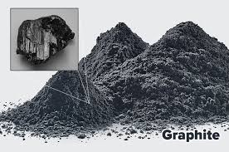
GRAPHITE
Graphite, a naturally occurring form of crystalline carbon, is crucial for Li-ion battery anodes.
Key properties of graphite for batteries:
High electrical conductivity: Enables efficient charge flow.
Layered structure: Allows for lithium ion storage (intercalation).
Stability: Maintains structural integrity during charge/discharge cycles.

Slide 14
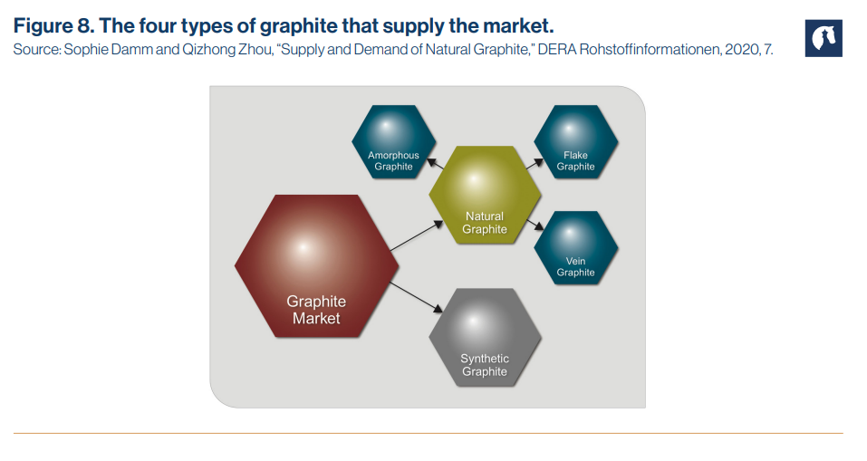
GRAPHITE SOURCES: NATURAL - SYNTHETIC
Two main types of graphite:
Natural graphite: Extracted from metamorphic rock or coal seams.
Properties:
Higher purity and crystallinity
Superior electrical conductivity
Better thermal stability
Applications:
High-performance Li-ion batteries
Electronic devices
Nuclear applications
Synthetic graphite: Produced from petroleum coke or natural gas.
Properties:
Lower purity and crystallinity
Less expensive
More environmentally friendly production
Applications:
Low-cost Li-ion batteries
Electrical conductors
Lubricants

Slide 15
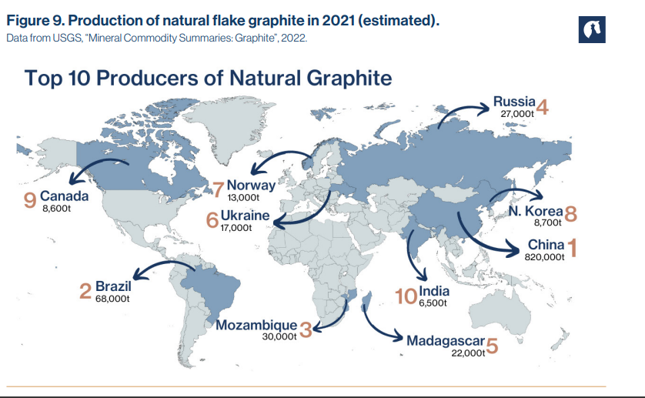
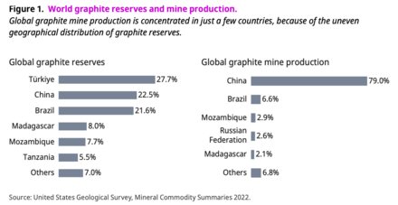
Global Graphite Reserves
Estimated global graphite reserves: 1.5 billion tonnes
Distribution of graphite reserves:
Africa: 40%
Asia: 30%
North America: 15%
South America: 10%
Europe: 5%

Slide 16
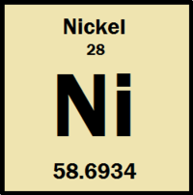
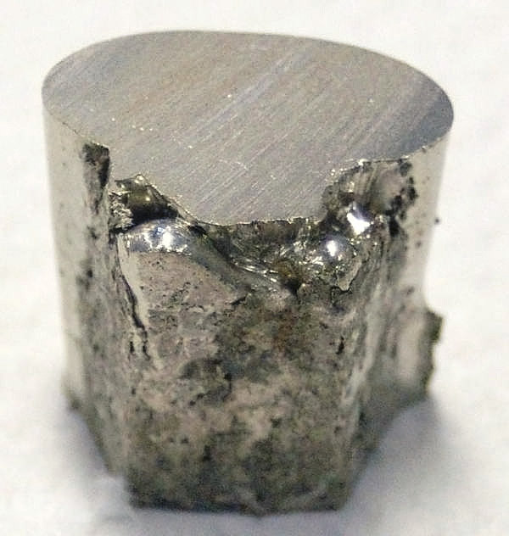
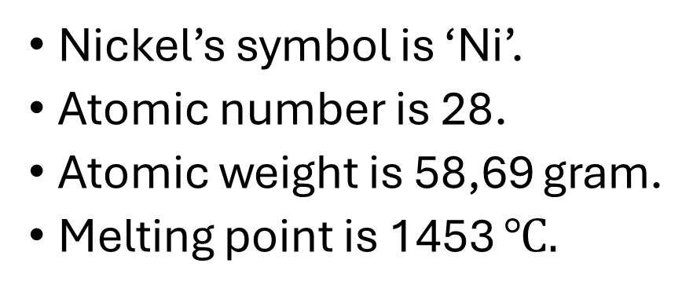
Properties of Nickel
Nickel’s symbol is ‘Ni’.
Atomic number is 28.
Atomic weight is 58,69 gram.
Melting point is 1453 $℃.$

Slide 17
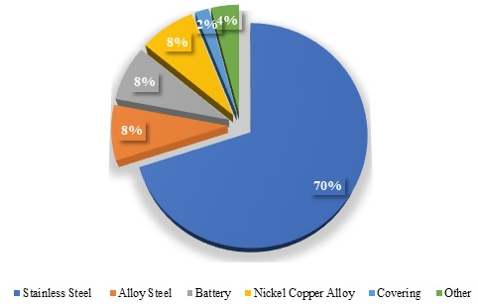
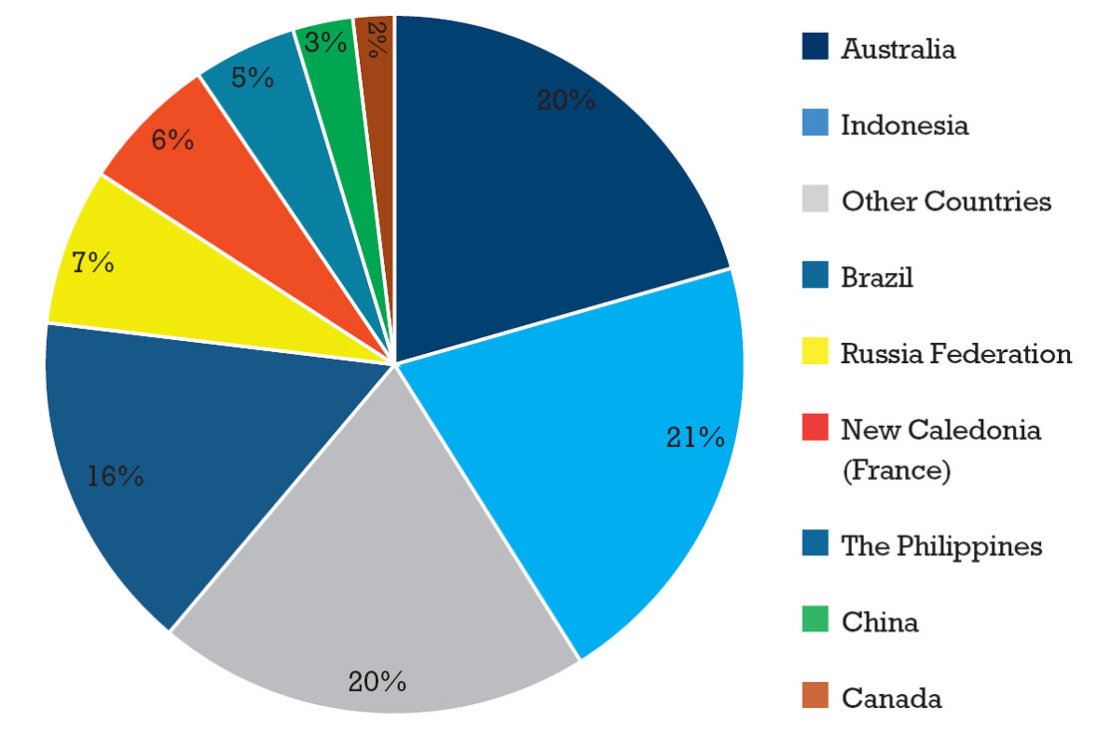
APPLICATION AREAS OF NICKEL&RESERVES
Mostly found in Indonesia

Slide 18
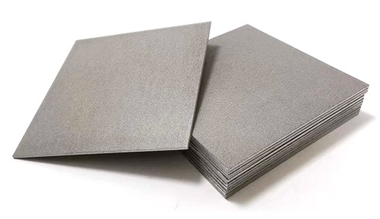
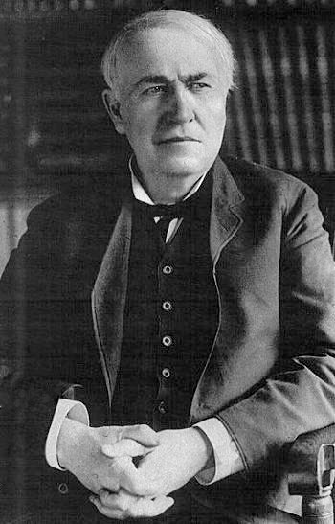
Use of Nickel in Battery
sintered nickel plate sample
Edison's 1908 tubular plate design improved durability.
Pflider's sintered plate technology in 1928 revolutionized a field now dominated by sintered nickel electrodes.

Slide 19
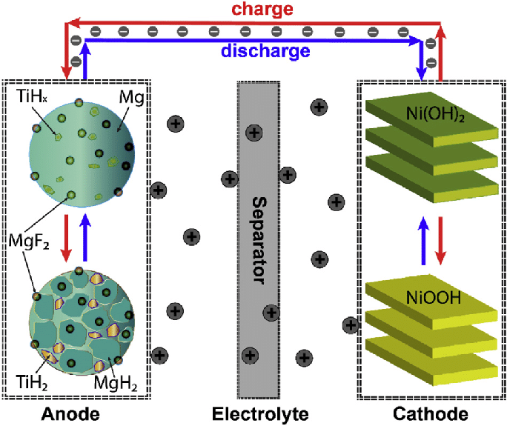
A schematic of the Ni-MH battery with a Ni(OH)2 cathode and an anode based on TiF₃ catalyzed Mg.

Slide 20
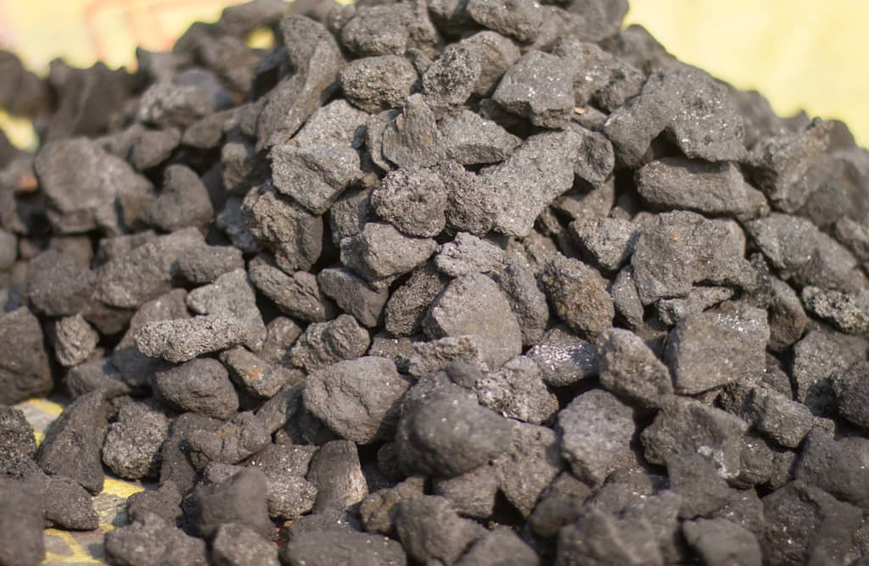
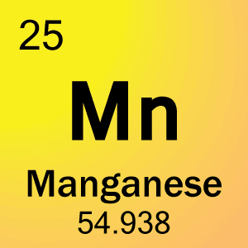
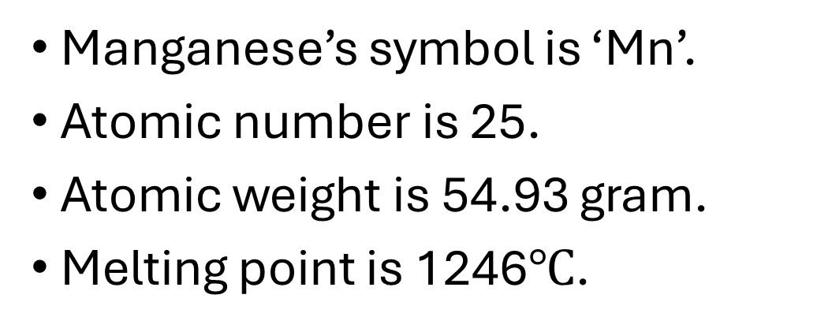
Properties of Manganese
Manganese’s symbol is ‘Mn’.
Atomic number is 25.
Atomic weight is 54.93 gram.
Melting point is 1246$℃$.

Slide 21
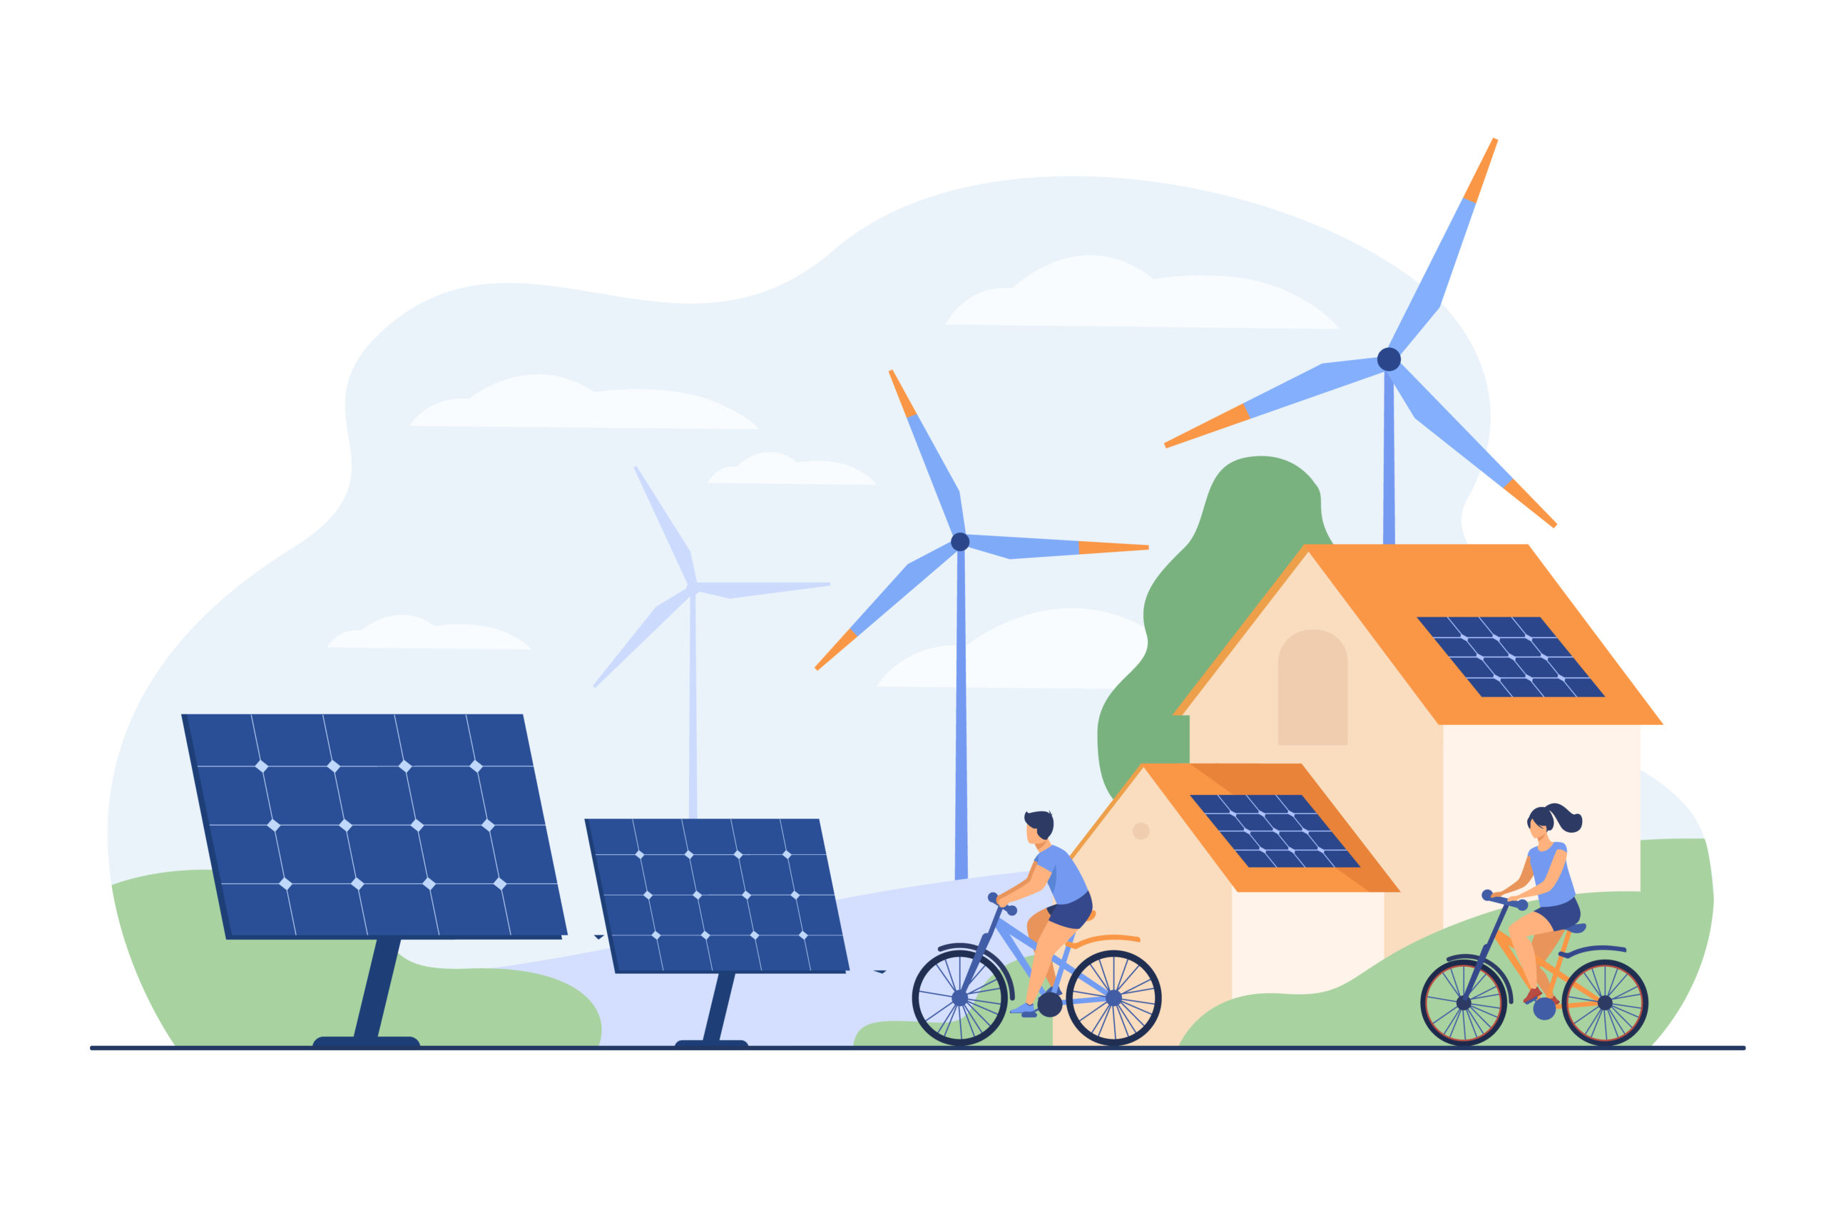
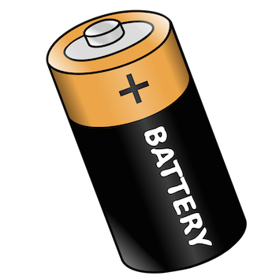
Application Areas of Manganese
We can use for battery production.
We can use for renewable sources.

Slide 22
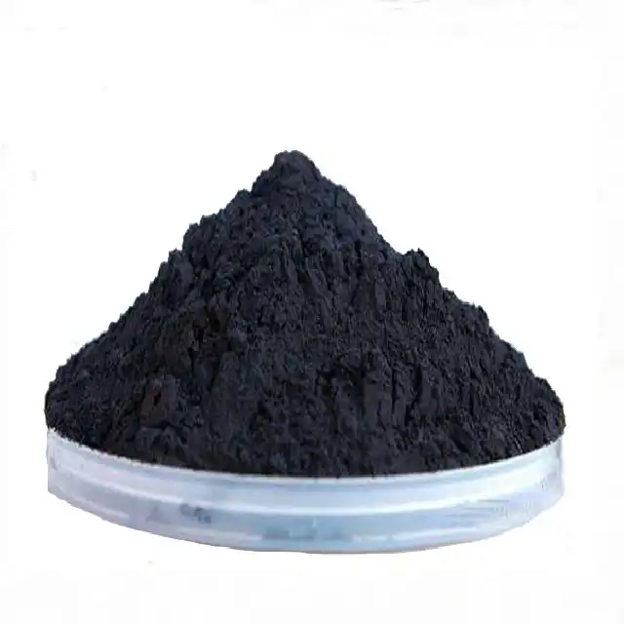
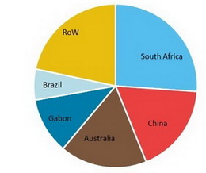
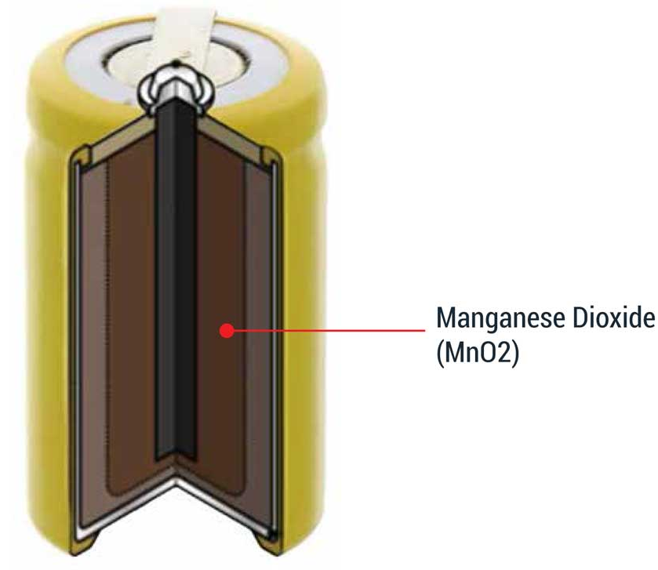
Reserves of Manganese & Its Use in Battery
Most sources are in South Africa
Example of the use of manganese in the battery

Slide 23
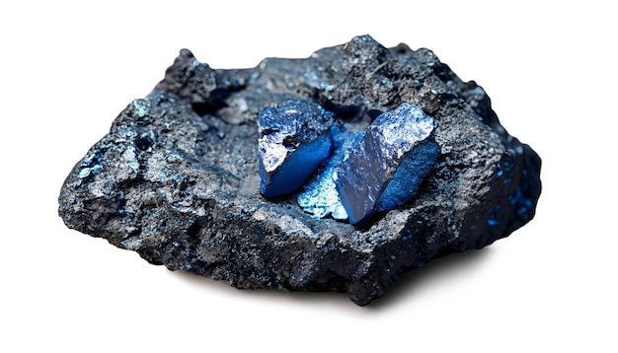
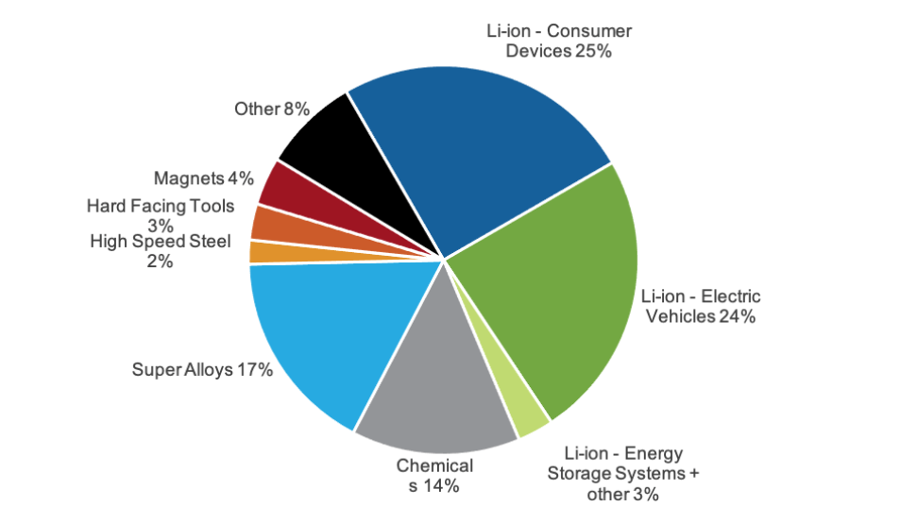
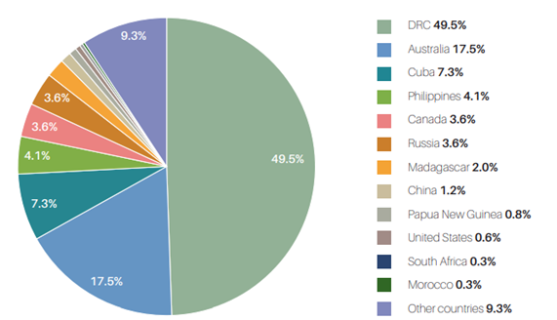
COBALT
Main source as raw material in LCO, NMC and NCA.
High capacity, good cycling, low self discharge
Cobalt demand for various industries in 2021.
Cobalt resources around the Globe.

Slide 24
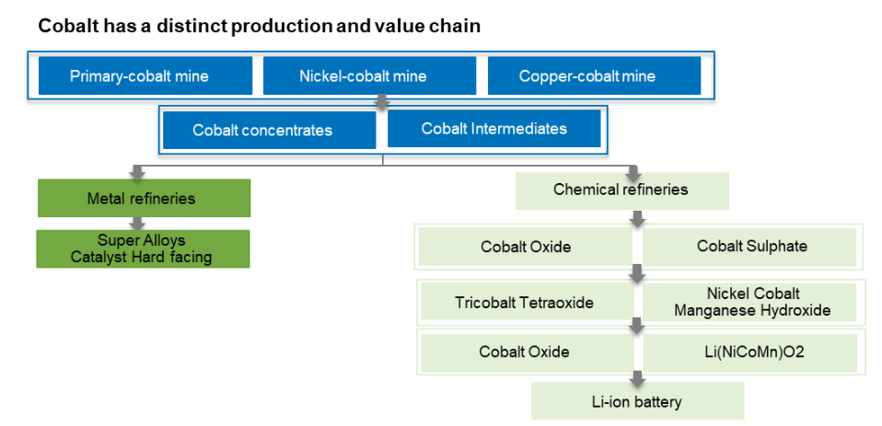
PRODUCTION METHODS OF COBALT
Cobalt is mostly produced through mining activities.
It is mostly obtained as a by-product from nickel and copper mining.
Value chain and production methods of Cobalt.

Slide 25
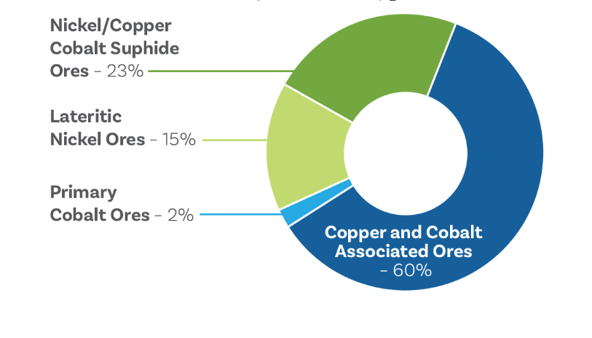
PRODUCTION METHODS OF COBALT
Since it is produced as a by-product predominantly, its production highly depends on nickel and copper mining activities thus resulting in price fluctuations and even shortages occasionally
Distribution of cobalt resources

Slide 26
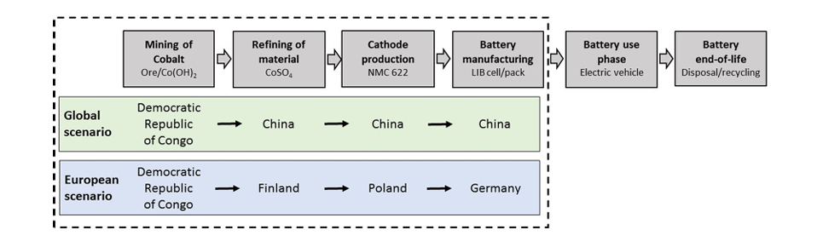
PROCUREMENT ROUTES FOR COBALT
Congo holds greatest amount of reservoir.
Asia dominates the LIB and cathode production market
Finland holds most of the resources for Europe.

Slide 27
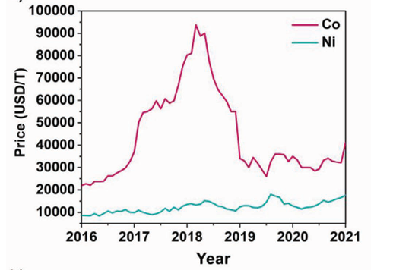
PRICE FLUCTUATIONS FOR COBALT
The peaks on the graph appear due to cobalt shortages
Nickel prices are less volatile even though cobalt mining mostly depends on nickel ores.

Slide 28
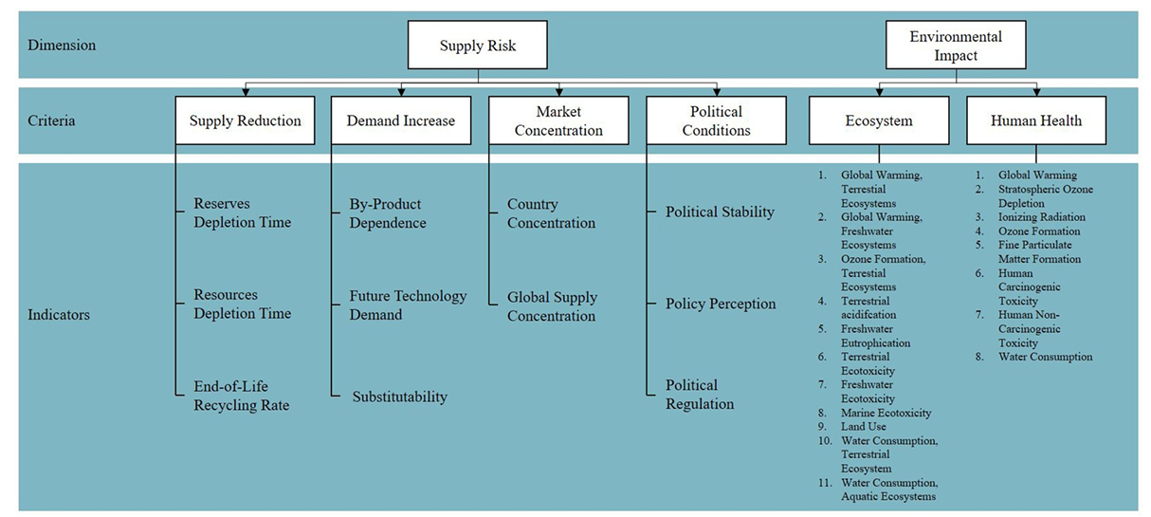
SUPPLY CHAIN ASPECT OF CRM

Slide 29
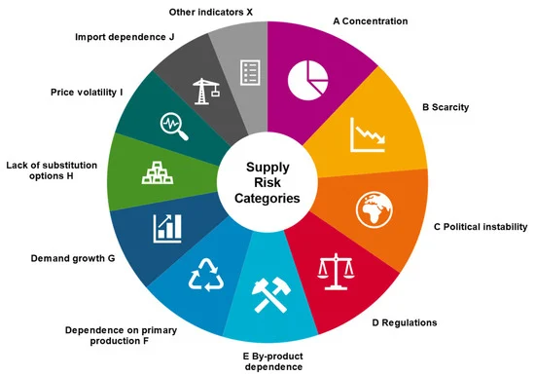
SUPPLY CHAIN ASPECT OF CRM
Economic value and environmental impacts should be taken into account when considering supply chain.
For each mineral the weight of the criteria is different.

Slide 30
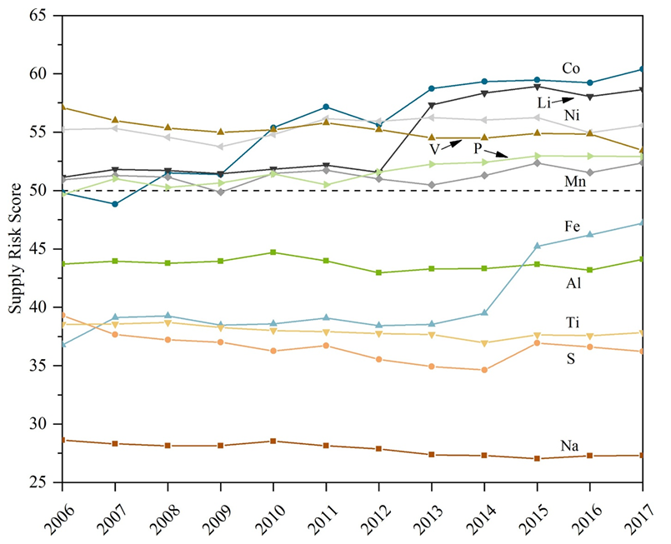
SUPPLY RISK EVALUATION OF CRM
According to this graph Li,Ni,Co and Mn are considered as high-risk in terms of procurement.
This is mainly due to scarcity of resources, political issues and unforeseen demand.

Slide 31
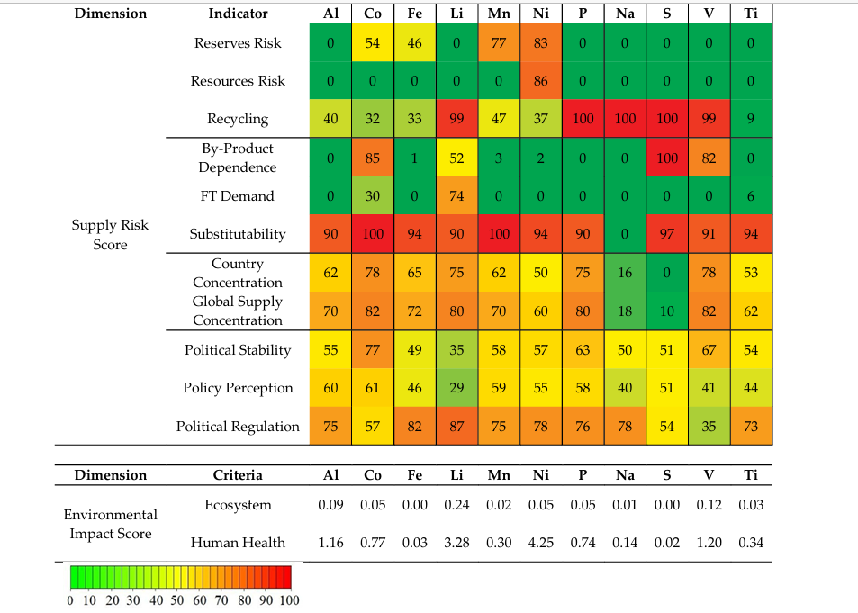
OVERALL RISK EVALUATION BASED ON CRITERIA

Slide 32
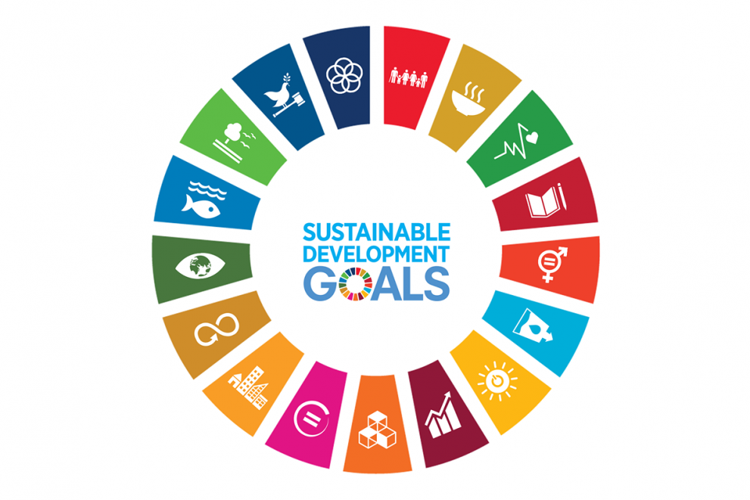
SUSTAINABILITY OF CRITICAL RAW MATERIALS
Sustainability Challenges
Raw Material Issues: Limited resources and environmental impacts of extracting materials like lithium, cobalt, and nickel.
Recycling: Complex and costly recycling processes for lithium-ion batteries.
Supply Chain Sustainability: Sustainability issues and geopolitical risks in the supply chain of critical raw materials for lithium-ion batteries.

Slide 33

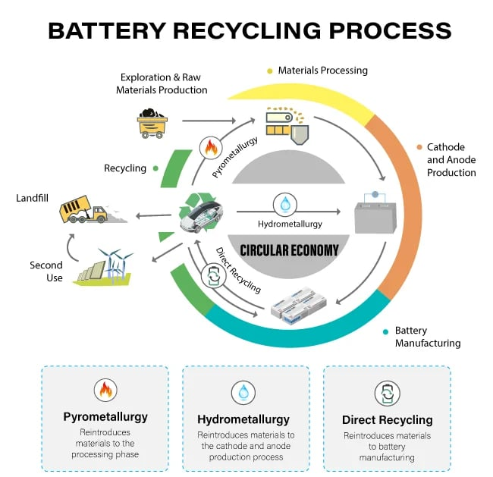
SUSTAINABILITY OF CRITICAL RAW MATERIALS
Proposed Solutions
Better Design: Designing batteries for longer life and easier recycling.
Improved Recycling Processes: Developing better recycling processes for lithium-ion batteries to reduce costs.
Alternative Materials: Researching alternative materials to replace critical raw materials in lithium-ion batteries.

Slide 34
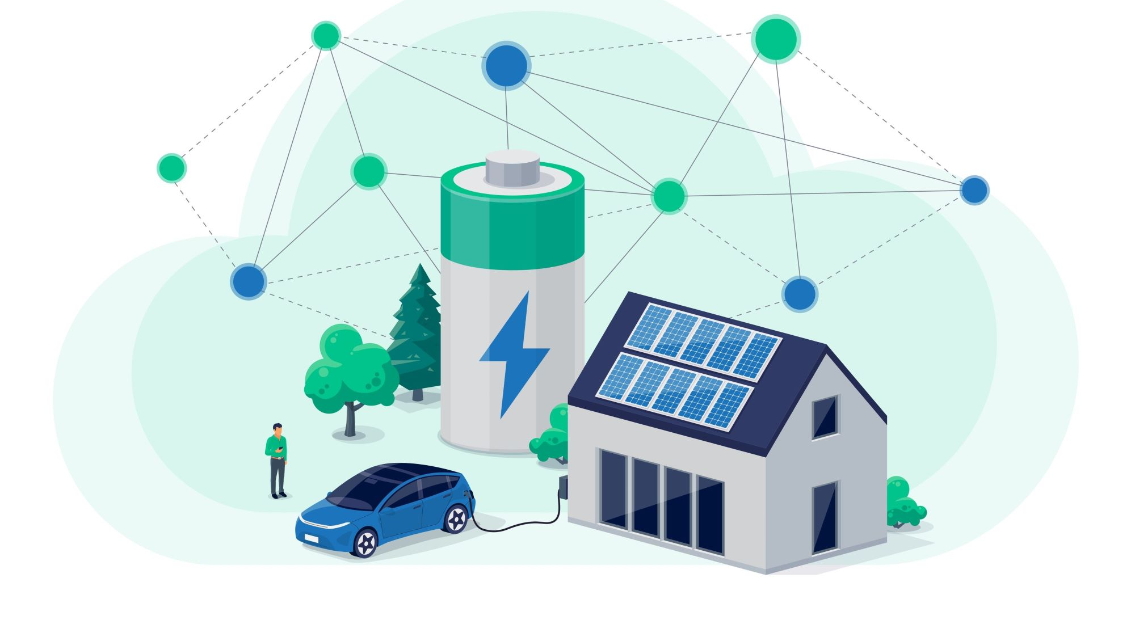
THANK YOU FOR YOUR ATTENTION !

